Slide 1
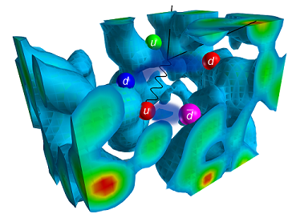
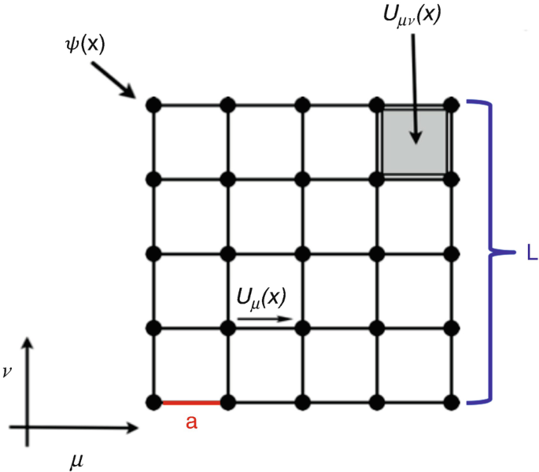
Correlation Function Analysis
Mentors:
Brij Kishor Jashal (TIFR)
Archana Radhakrishnan (TIFR)
Adam Zacharia Anil

Slide 2

Correlation Function Analysis
Adam Zacharia Anil
About me
I am an aspiring astrophysicist currently pursuing a BS-MS dual degree at the Indian Institute of Science Education and Research (IISER), Thiruvananthapuram. With a major in Physics and a minor in Data Science, I am passionate about unlocking the mysteries of the universe through the power of big data analysis and computational methods.
Where am I from
Kerala, India
I am from Kollam which is one of the 14 districts in Kerala
Research Interests
Astrophysics, Machine Learning
I am Interested Gravitational wave, GRBs ,
Astro particlephysics, Kilonoave
Website
More Info
https://www.adamzacharia.com/

Slide 3
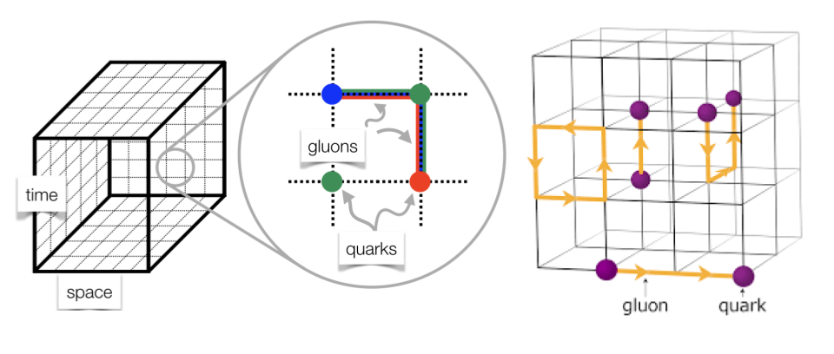
Correlation Function Analysis
What is Lattice QCD ?
Lattice QCD is a computational method in quantum physics that discretizes spacetime onto a grid or lattice. By doing this, it enables numerical solutions for the non-perturbative regime of Quantum Chromodynamics, which describes the strong force interactions between quarks and gluons.
Or in very simple terms
Imagine you want to understand how the tiny particles inside atoms (quarks and gluons) stick together. Lattice QCD is like a super-detailed Minecraft world for scientists. Instead of continuous land, they use blocks (or grid points) to represent space and time, which makes it easier to run computer simulations and figure out how these particles interact.

Slide 4
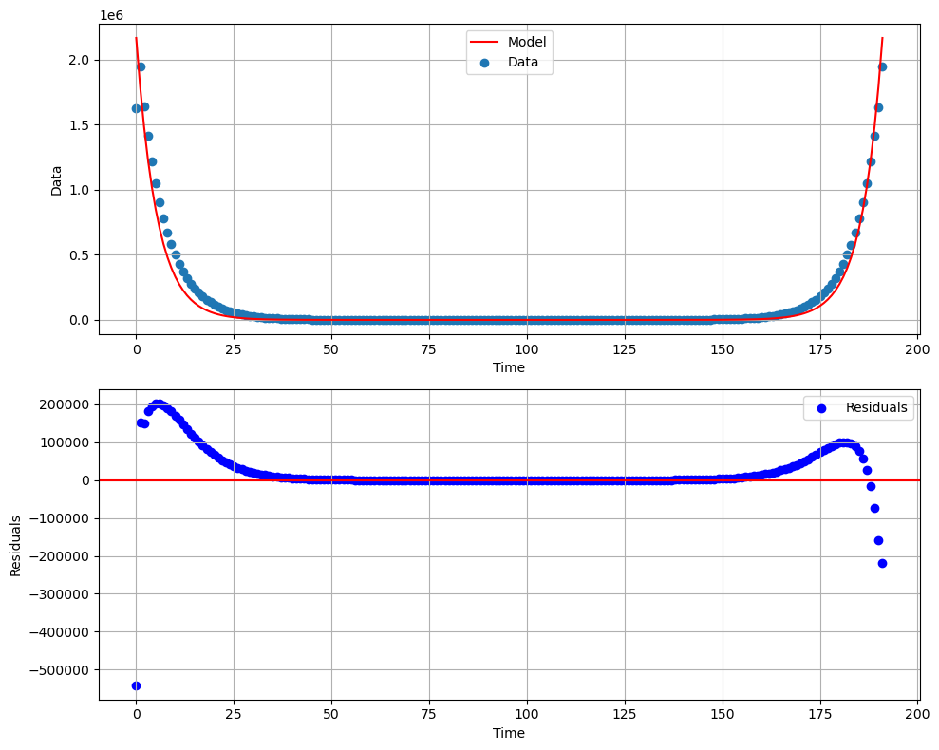
Correlation Function Analysis
What is Two point Correlation function ?
In Lattice QCD, a two-point correlation function measures the probability amplitude for a quark to propagate from one point in spacetime to another. Mathematically, it represents the expectation value of the product of two field operators, separated in time. By studying how this function decays with time separation, one can extract the mass of the bound state (like a proton or a pion) associated with the quark fields.
Okay now lets see how we can simply explain it using an analogy

Slide 5
Correlation Function Analysis
What is Two point Correlation function ?
Imagine you're dropping a stone into a pond and watching the ripples it creates. A two-point correlation function in Lattice QCD is like watching two specific points on the water to see how they respond over time. By looking at how the ripples at one point relate to the ripples at another point, we can figure out some properties of the tiny particles inside atoms.

Slide 6
Correlation Function Analysis

Slide 7
Correlation Function Analysis
The jackknife method involves systematically leaving out one observation at a time from the sample set and calculating the estimate over n-1 observations. By doing this for all observations in the sample and examining the variation among the results, one can estimate the bias and variance of the estimator. It's a resampling technique, similar in spirit to the bootstrap, but with its own strengths and weaknesses.
Imagine you have a bag of mixed candies and you want to estimate the average weight of a candy. You might take a handful and average their weights. But, what if, by chance, you grabbed a handful with unusually heavy or light candies? The jackknife method is like weighing the candies in your handful one by one, leaving one out each time, to see if that candy was affecting the average weight a lot. This helps you understand if your average is reliable or if it's being skewed by just one or two candies.

Slide 8
Correlation Function Analysis
Bootstrap estimation is a powerful resampling technique used to infer the distribution of a statistic (like the mean or variance) by repeatedly sampling subsets of the observed data with replacement. The key idea is to simulate the process of obtaining new sample sets by drawing from the original dataset. By doing this many times (say thousands or even millions), you can build an empirical distribution of the statistic and estimate its variance, confidence intervals, and more.
Imagine you have a bag of mixed candies, and you want to guess the average weight of a candy. To use the bootstrap method, you'd take a handful of candies, record the average weight, then put them back in the bag and mix them up. You'd repeat this process many times. Each time you might get a slightly different average because you're picking candies randomly. After doing this many times, you'd look at all the averages you wrote down. The range and pattern of those averages give you a good idea about the true average weight of the candies in the bag and how sure you are about it!

Slide 9
Correlation Function Analysis
**Advantages of Jackknife over Bootstrap in Lattice QCD:**
1. **Simplicity in Implementation**: For Lattice QCD datasets, which can be computationally intense, the jackknife method can be simpler and quicker because it involves a fixed number of resamples.
2. **Deterministic Results**: Each run of a jackknife analysis will yield the same result, which can be advantageous when comparing results between research groups or when trying to track down the source of an inconsistency.
3. **Smaller Data Overhead**: Jackknife doesn't require storing multiple resamples, which can be beneficial given the large datasets often encountered in Lattice QCD.
4. **Good for Large Data Sets**: When the configurations are numerous (typical in many Lattice QCD calculations), jackknife can provide reliable error estimates without the need for more extensive resampling.

Slide 10
Correlation Function Analysis
**Advantages of Bootstrap over Jackknife in Lattice QCD:**
1. **Robustness with Non-Gaussian Distributions**: Lattice QCD observables can sometimes have non-Gaussian distributions. Bootstrap can be more robust in such cases, providing a more accurate representation of uncertainties.
2. **Flexibility with Complex Observables**: When dealing with intricate correlation functions or multi-point functions, the bootstrap might offer a more flexible approach to error estimation.
3. **Estimation of Full Distributions**: For some Lattice QCD calculations, it's beneficial to understand the full distribution of an observable, not just its average and variance. Bootstrap can provide this broader view.
4. **Better for Smaller Data Sets**: In situations where the number of gauge configurations is limited, bootstrap might give a more accurate estimate of uncertainties as it allows for deeper resampling.
5. **Nonlinear Error Propagation**: For observables derived from nonlinear combinations of primary measurements, bootstrap can be more reliable in propagating errors.
In the context of Lattice QCD, the choice between jackknife and bootstrap often comes down to the specific nature of the calculation, the size of the dataset, and the type of observables under investigation. Both methods are valuable tools, and their applicability should be evaluated on a case-by-case basis.

